Slide 1


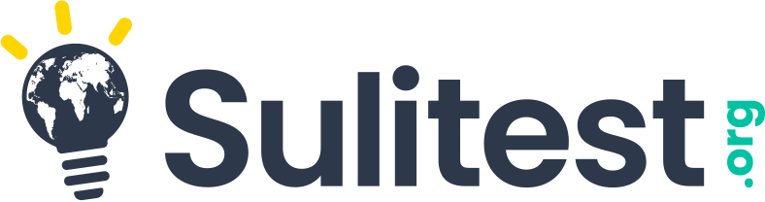
Mainstreaming Sustainability Literacy together!

Slide 2
Mainstream sustainability literacy
HOW CAN YOU…
Know
the sustainability level of your incoming students in order to adapt pedagogy?
Ensure
all your graduates acquire sufficient sustainability knowledge?
Report
your impact to accreditation and ranking agencies?

Slide 3
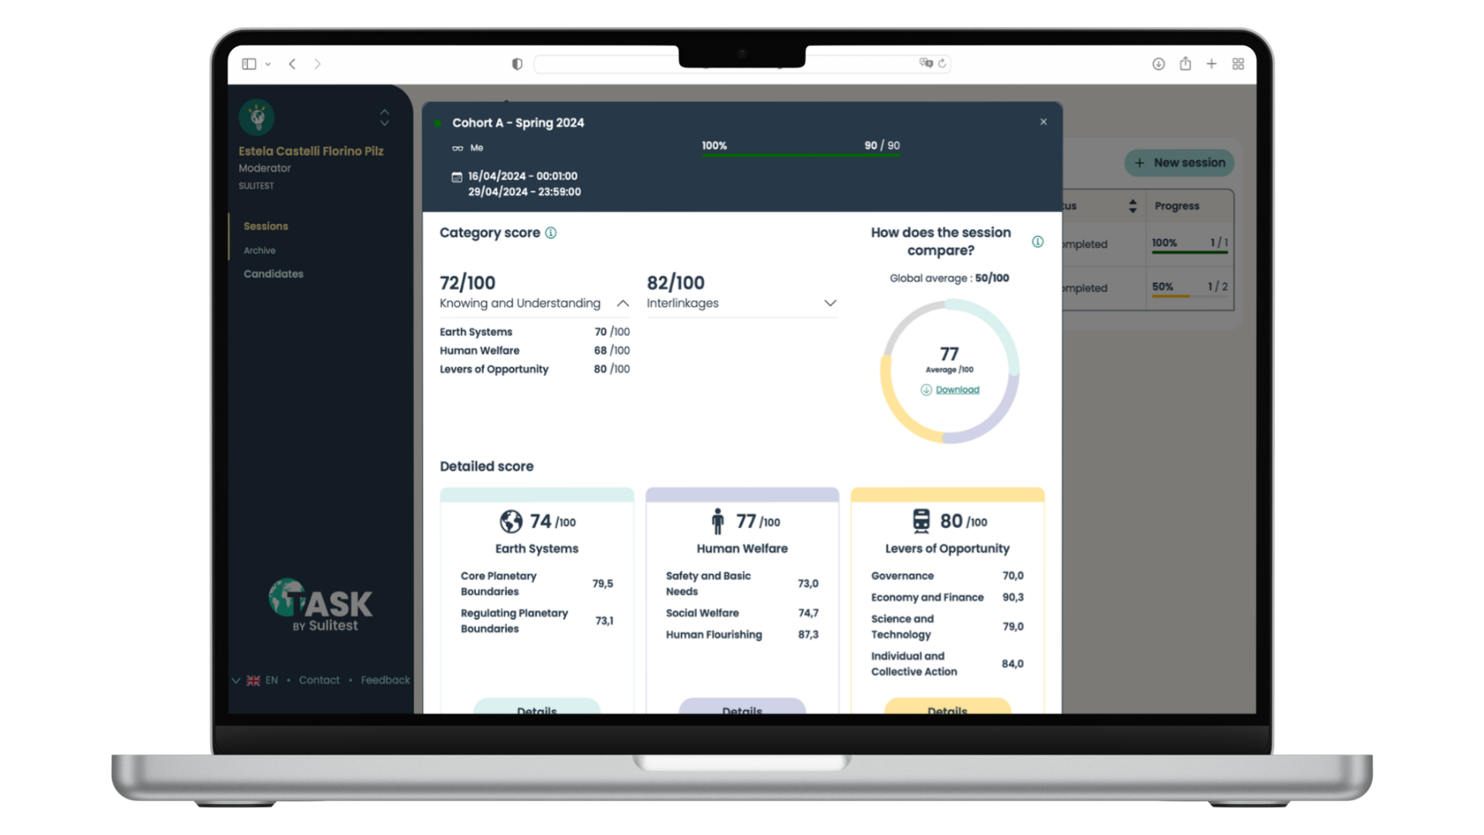
Assess with TASK™
THE ASSESSMENT OF SUSTAINABILITY KNOWLEDGE
The 1st psychometric tool to monitor and certify the sustainability knowledge of your students
Measure knowledge at the beginning, during, and at the end of their studies
Pilot your education for sustainability strategy with robust, reliable, & comparable data
Showcase your impact (+ enable your students to showcase their knowledge with a certificate!)

Slide 4
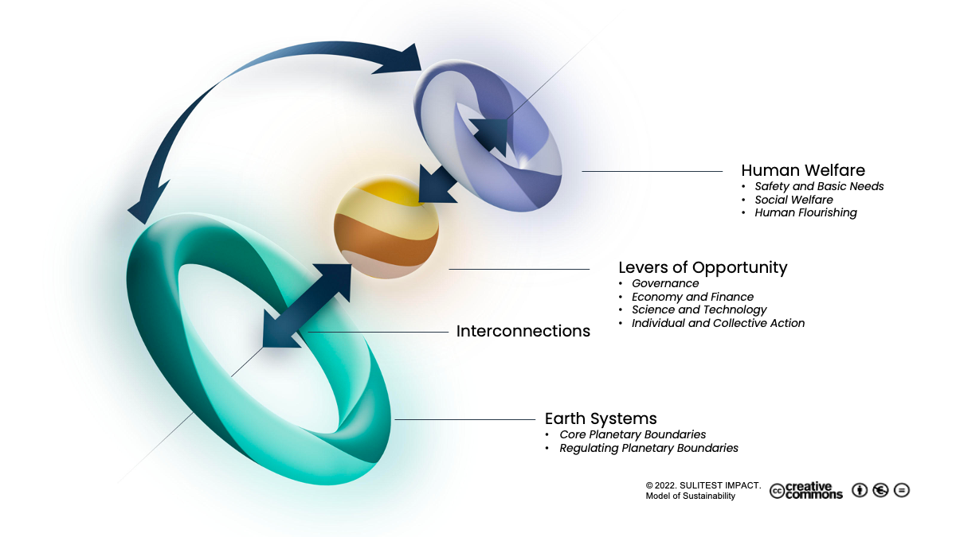
What is TASK™ about?
We believe all individuals should know and understand the planetary boundaries (Earth system), the main foundations of human welfare, and the multiple interconnections existing between these dimensions.
All individuals should also know and understand the importance of action-based levers of opportunity, forces that interact on all dimensions of sustainability and can be leveraged in building a sustainable future.
TASK™ is about sustainability as a common language and that's what makes it relevant for all students!

Slide 5
3 easy steps
1. Invite staff, professors, and students to take TASK™
2. Take TASK™ - asynchronous, online, 112 multiple-choice questions, 80 min
3. Receive the results (and certificate!)

Slide 6
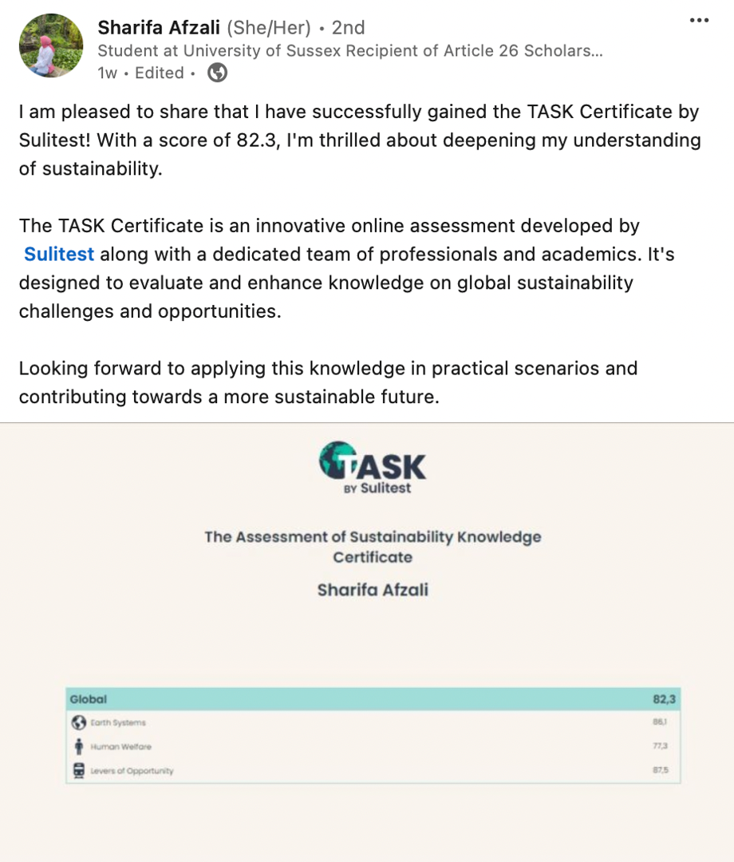
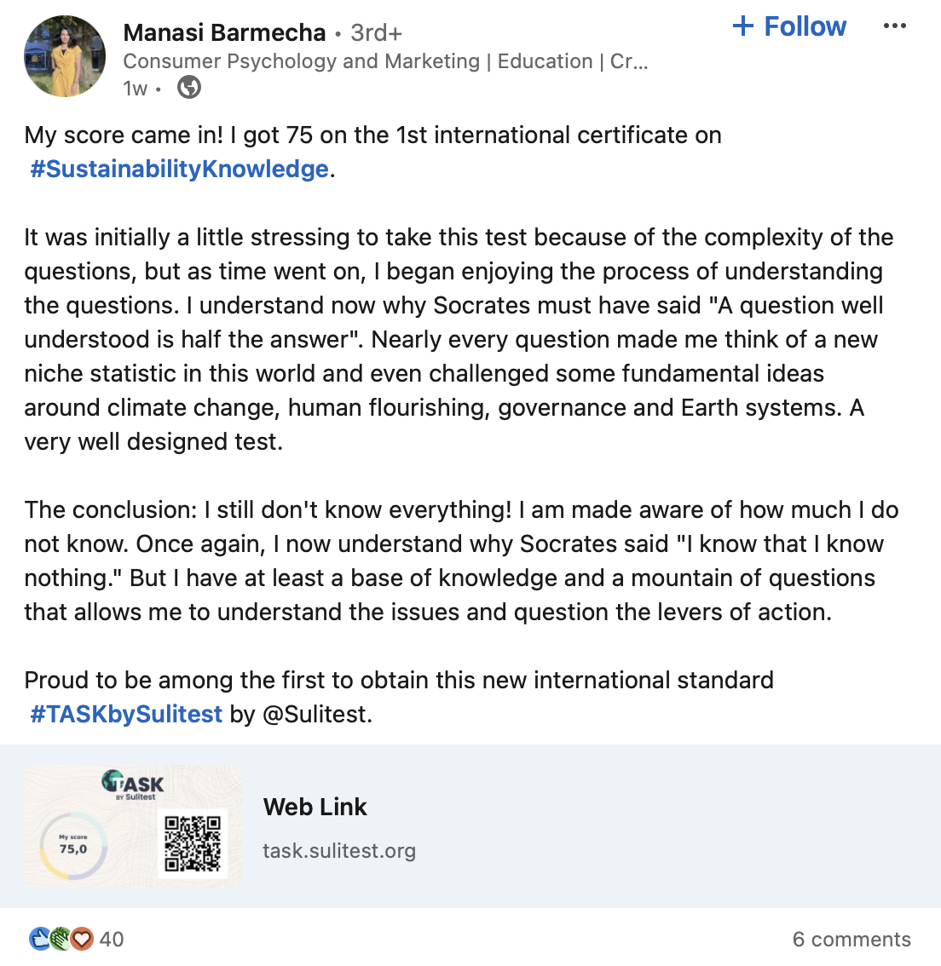
Sharing your sustainability certificate

Slide 7


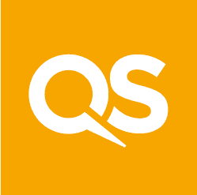
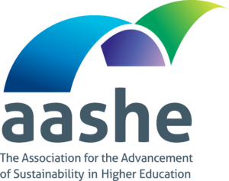



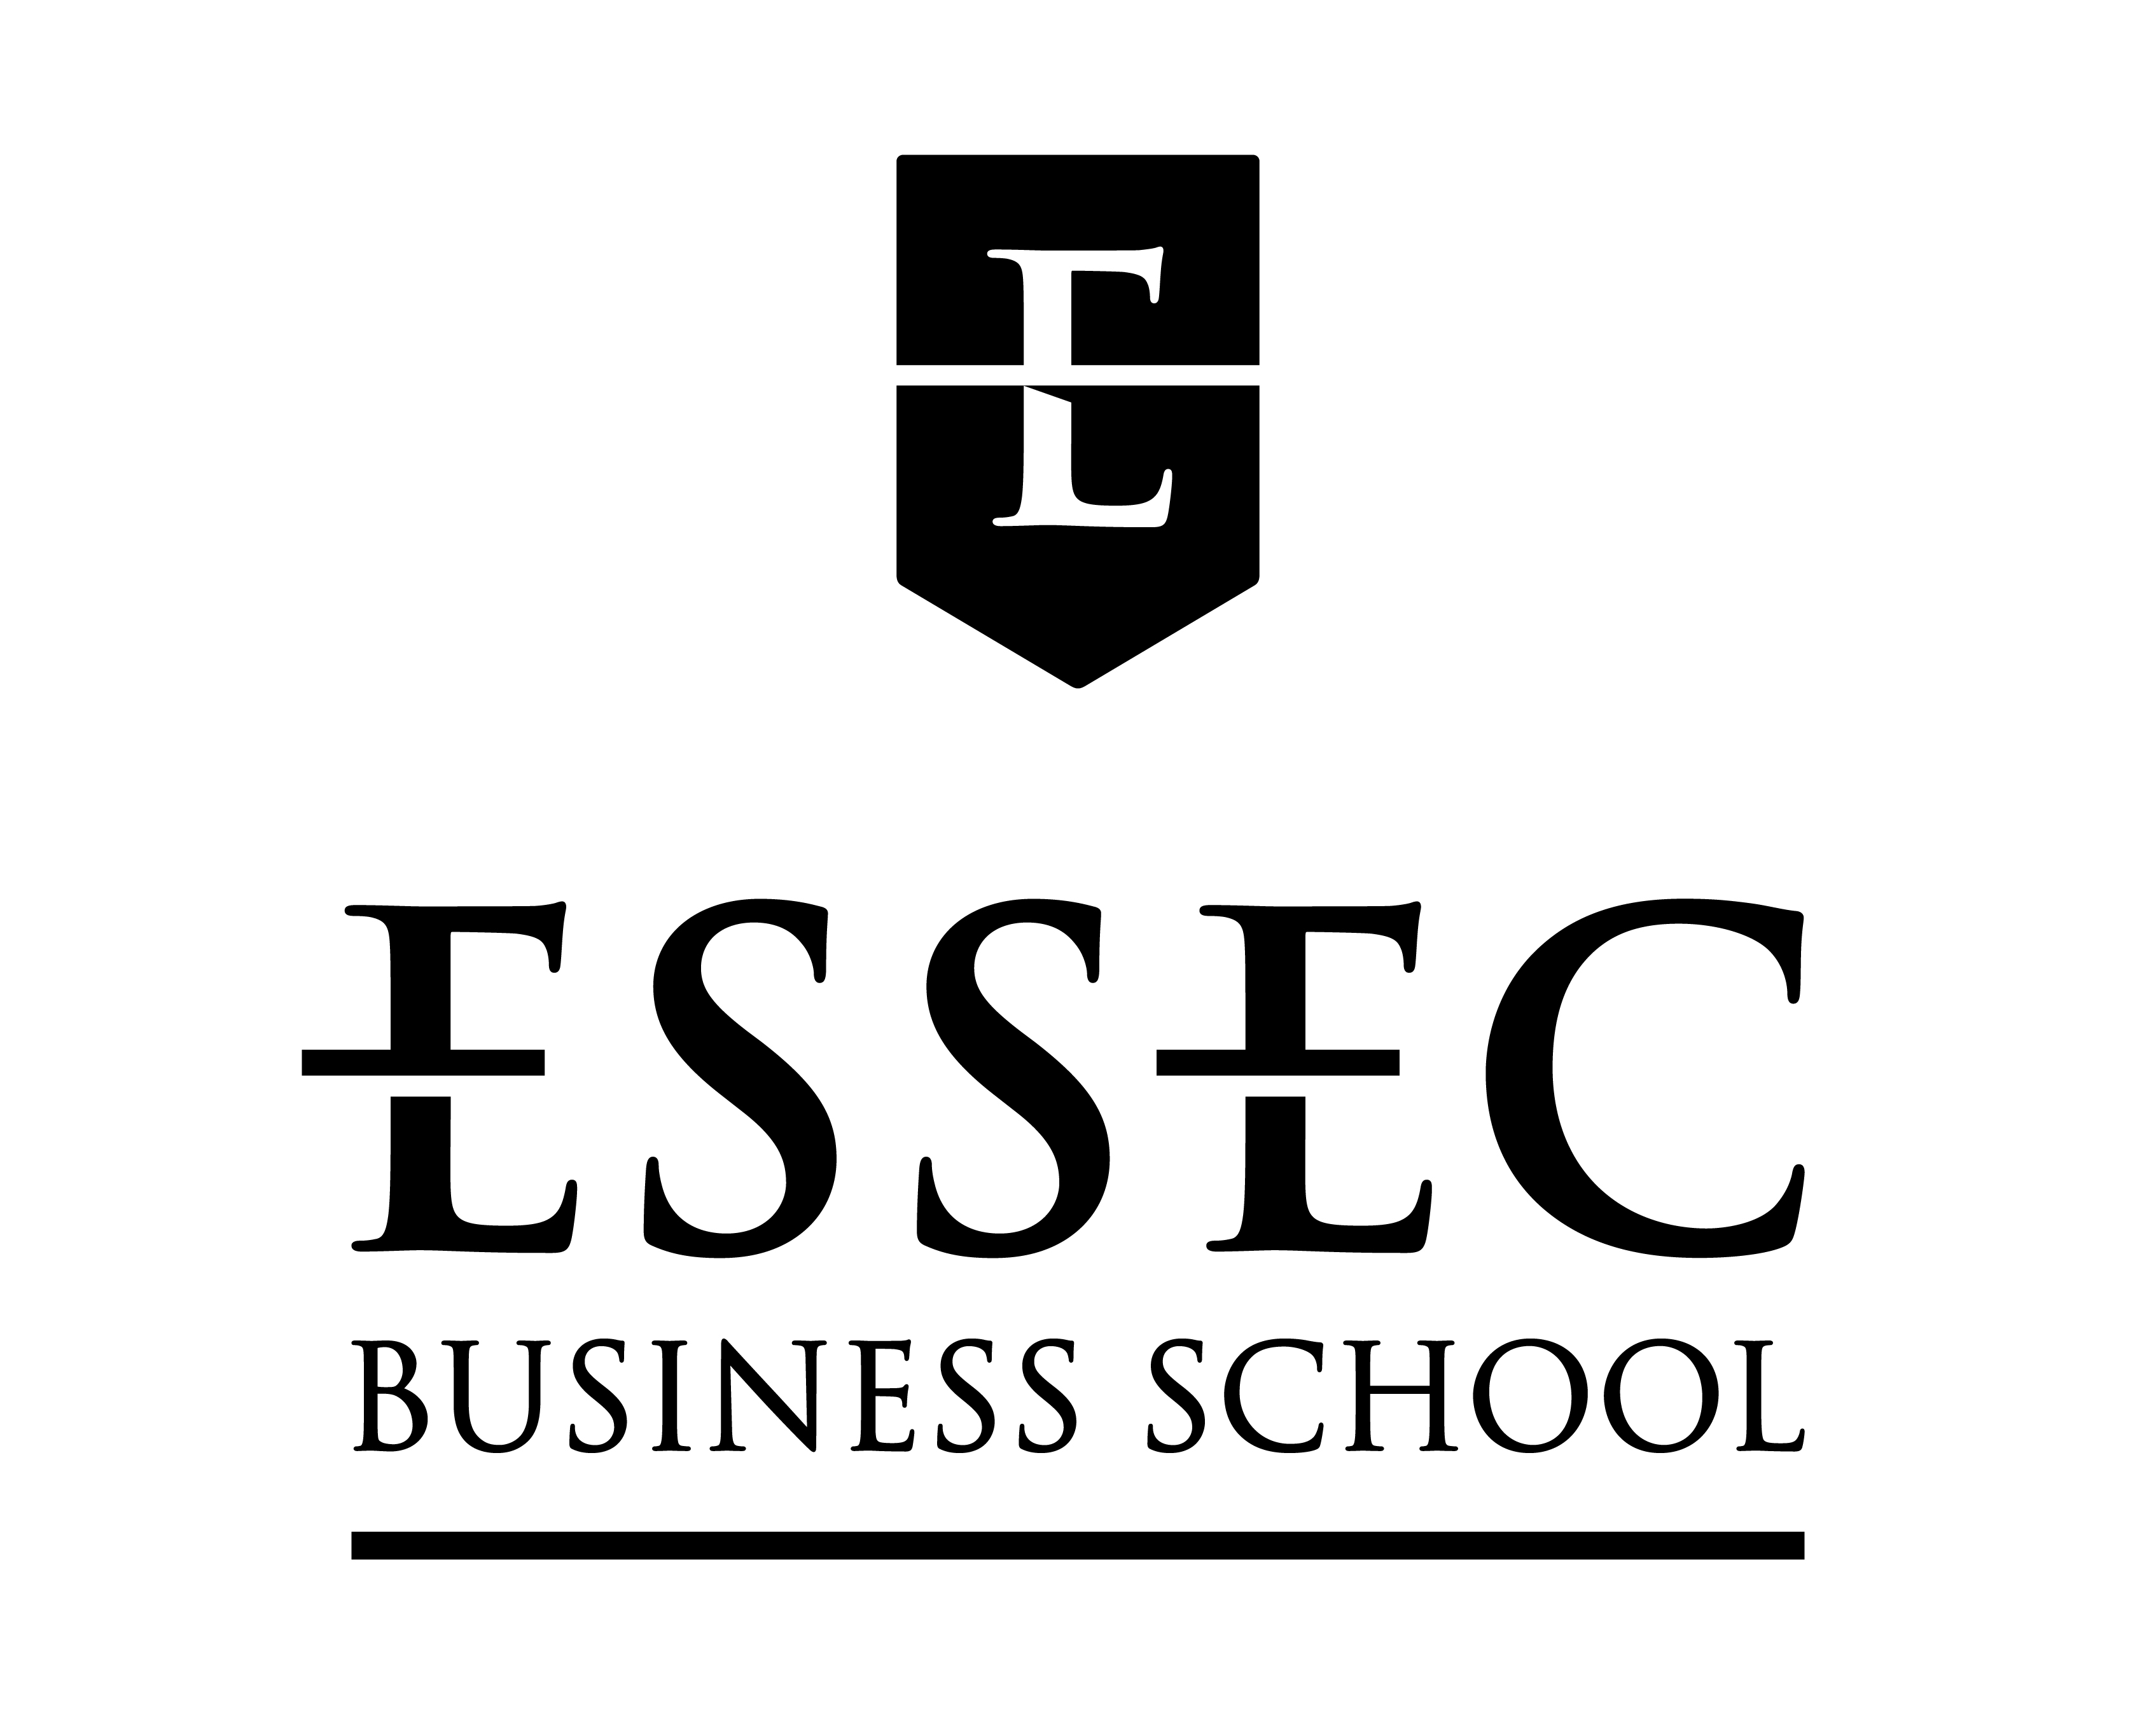

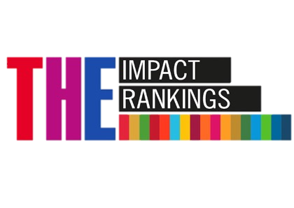


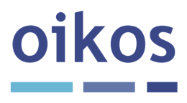

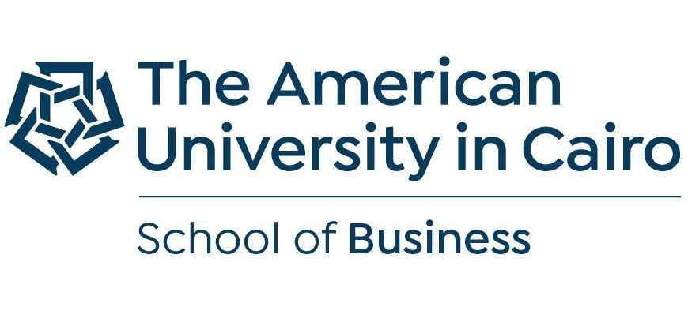



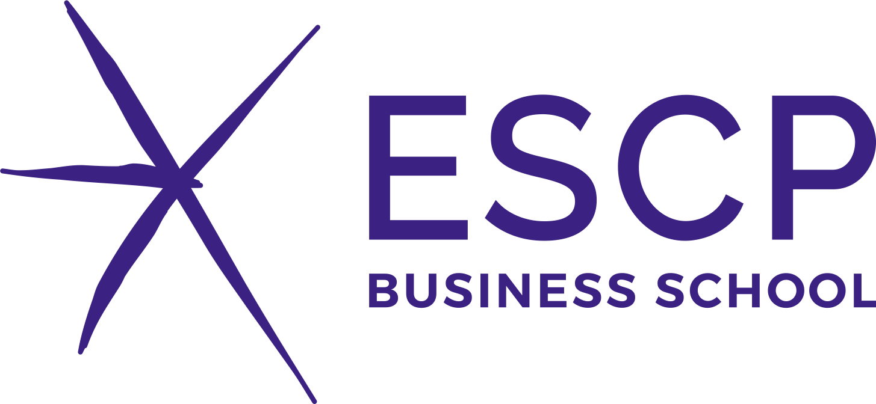
Trusted & supported by top institutions
Developed with
Endorsed by
Used by
70 representatives of academic networks, student networks, and researchers in Higher Ed.
key top accreditation and ranking agencies, among other stakeholders
50+ universities and business schools globally

Slide 8
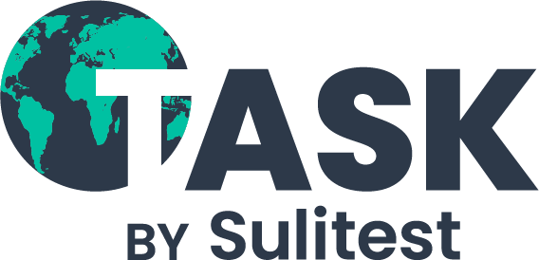
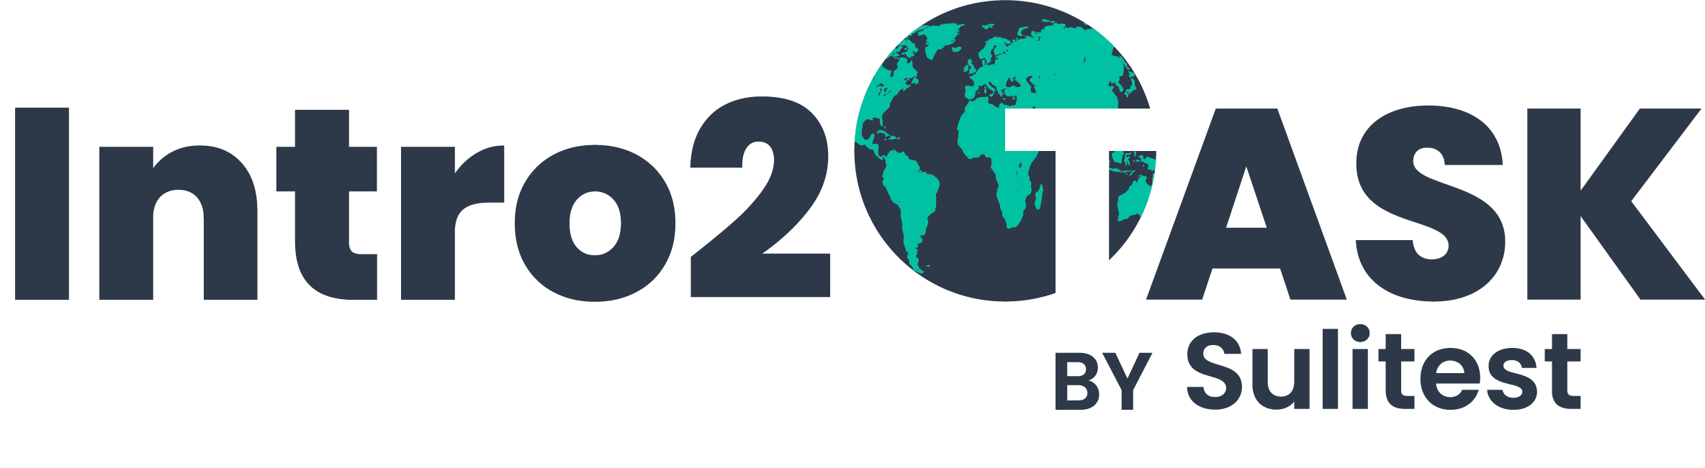
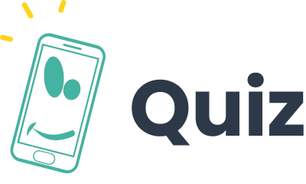


Deployment suggestion
1ST SEMESTER
AT GRADUATION
RAISE AWARENESS
ENTRY-ASSESSMENT
Establish a baseline of “what do my students know and what is there to learn?”
SUSTAINABILITY IN THE CURRICULA
To support pedagogical design and curricular review:
- TASK Navigational Charts as a framework for EfS
- Change Leader Workshops
EXIT-ASSESSMENT
Measure “what have my students learned about sustainability?”
*OPTIONAL
MEASURE AND SHOW YOUR IMPACT IN ACCREDITATIONS, RANKINGS, ETC.
INFORM YOUR EDUCATION FOR SUSTAINABILITY STRATEGY
USE OUR TOOLS TO RAISE AWARENESS AND GET STUDENTS ONBOARD. OPTIONAL IF YOU PREFER A “RAW” FIRST ASSESSMENT

Slide 9

Let’s mainstream sustainability literacy together!
estela@sulitest.org

Slide 10
Appendix

Slide 11
A movement to mainstream sustainability
85%
of students want to learn more about sustainability*
100%
of top ranking and accreditation agencies have sustainability requirements
Institutions want to embed sustainability into their pedagogy but most don’t know how to monitor and pilot it
Source: * The 2020 Global Survey on Sustainability and Education, by SOS-International
Notes:
Problem / situation : killer data
Everyone is concerned about sustainability

Slide 12
Deployment suggestion
1ST SEMESTER
AT GRADUATION
RAISE AWARENESS
ENTRY-ASSESSMENT
Establish a baseline of “what do my students know and what is there to learn?”
SUSTAINABILITY IN THE CURRICULA
To support pedagogical design and curricular review:
- TASK Navigational Charts as a framework for EfS
- Change Leader Workshops
EXIT-ASSESSMENT
Measure “what have my students learned about sustainability?”
*OPTIONAL
MEASURE AND SHOW YOUR IMPACT IN ACCREDITATIONS, RANKINGS, ETC.
INFORM YOUR EDUCATION FOR SUSTAINABILITY STRATEGY
USE OUR TOOLS TO RAISE AWARENESS AND GET STUDENTS ONBOARD. OPTIONAL IF YOU PREFER A “RAW” FIRST ASSESSMENT

Slide 13
“At UDEM, we have been using Sulitest as part of an introductory course for all our first-year students.
Sulitest has served as a conversation detonator and an eye-opener because it gives our students a broad picture of global issues, trends, and data they should know about what is happening in the world.”
– Alfredo Nanni, Sustainability Coordinator at Universidad de Monterrey
Awareness Test
Individual test with 28 questions
Participants "learn as they go" when answering the different questions, and often leave with a broader understanding of sustainability
Optional modules linked to a specific country, SDG, or topic of choice, through customization.

Slide 14
“The Sulitest is an amazing tool in training students to acquire the essential knowledge of the social and economic transition.
We like to use the SuliQuiz which is a great way to introduce the SDGs and to start discussions about it.”
– Salomé Falise, (Former) Director at Impact Campus
Quiz
Played as an interactive game between several teams
6 to 10 questions
Useful during board meetings, classes, and other events to raise awareness on sustainability
Similarly, participants learn as they answer to the different questions, and often leave with a broader understanding of sustainability
Notes:
TASK in a nutshell / What does TASK do?
Explain the why in the verbal pitch
- Why do we assess at the beginning? -> bc how can you know your pedagogy is adapted to the level of your students? To what they don’t know?
- Why do we assess at the end? -> to see if the strategy works, to show the impact you have

Slide 15
“The power of higher education to change the world exists both in what it is, but also more importantly in how it affects the futures of all students. Nurturing enquiring minds has always been part of that mission – but now it is more important than ever that it also encourages an aware, sustainable mindset in every student. Sulitest will support this, providing a common framework against which teaching in this vital area can be assessed.”
– Duncan Ross, Chief Data Officer at Times Higher Education
Intro2TASK
Compilation of resources to introduce students to sustainability subjects assessed in TASK™
Can be offered as is, or professors can pick from the compilation individual resources to use in their own courses
Approx. 5 hours of materials (videos)
Notes:
TASK in a nutshell / What does TASK do?
Explain the why in the verbal pitch
- Why do we assess at the beginning? -> bc how can you know your pedagogy is adapted to the level of your students? To what they don’t know?
- Why do we assess at the end? -> to see if the strategy works, to show the impact you have

Slide 16
Navigational Charts
Designed to inform the ongoing process of reviewing and revising course learning objectives and corresponding curricular content.
Each subject covered in TASK™ (i.e. Climate Change, Gender Equality, etc.) has a dedicated two-page chart outlining the definition of the subject, key international regulatory initiatives, key ideas/sub-topics, learning objectives, and key resources.
Notes:
TASK in a nutshell / What does TASK do?
Explain the why in the verbal pitch
- Why do we assess at the beginning? -> bc how can you know your pedagogy is adapted to the level of your students? To what they don’t know?
- Why do we assess at the end? -> to see if the strategy works, to show the impact you have

Slide 17
What is TASK™ about?
We believe all individuals should know and understand the planetary boundaries (Earth system), the main foundations of human welfare, and the multiple interconnections existing between these dimensions.
All individuals should also know and understand the importance of action-based levers of opportunity, forces that interact on all dimensions of sustainability and can be leveraged in building a sustainable future.
TASK™ is about sustainability as a common language and that's what makes it relevant for all students!

Slide 18
Earth Systems
Core planetary boundaries
Climate Change
Biosphere Integrity
Regulating planetary boundaries
Freshwater Use
Land-system Change
Ocean Acidification
Novel Entities
Biogeochemical Flows
Atmospheric Aerosols Loading
Stratospheric Ozone Depletion

Slide 19
Human Welfare
Safety & basic needs
Nutrition
Health
Access to Water and Sanitation
Housing and Human Settlements
Access to Energy
Social welfare
Basic Income
Social Equity
Gender Equality
Human Flourish - Emancipation
Education and Culture
Peace, Justice, and Political voice
Access to Networks and Social Interaction

Slide 20
Levers of Opportunity
Governance
Laws, Policies, and Institutions
Infrastructure, Planning, and Natural Resource Management
Economy and Finance
Macroeconomic Considerations and Finance
Microeconomic Considerations, Business, and Industry
Science and Technology
Sustainability Science
Technology and Innovation
Individual and Collective Action
Transformative Change
Cognitive Capacity for Sustainable Development

Slide 21
How are questions formulated?
Knowing & understanding
Interlinkages
Each subject has questions about:
Definitions and Key Concepts
Descriptive Knowledge
What are we talking about?
How does this work?"
Current State and Trends
Contextualized Knowledge
Where are we now?
How are things changing?
Major Causes
Causal Knowledge
Why is this happening?
Who is doing what and why?
Systemic Impacts
Integrated Knowledge
What are the related effects?
How is this affecting the larger system?
Earth System
Topic: i.e. Climate Change
A
C
D
E
Human Welfare
Topic: i.e. Gender Equality
A
C
D
E
Levers of Opportunity
Topic: i.e. Technology & Innovation
B
C
The letters indicate in which order the sections appear in the assessment.

Slide 23
“TASK is an innovative pedagogical tool that can be deployed in multiple ways to advance educational objectives in sustainability and global responsibility. I fully endorse this tool and encourage schools to contribute to the community working to ensure the Sulitest’s relevance for promoting action toward solving urgent global challenges and promoting transformation in sustainability education and beyond.”
– Eric Cornuel, Director General & CEO at EFMD
“As we face the climate catastrophe, the role of higher education in solving one the greatest challenges ever facing humanity has never been greater.
Sulitest provides an important lens on how well we are educating students to respond to this emergency - equipping institutions with vital insight to ensure they can adapt their pedagogical approaches and raise literacy around sustainability. This will drive the transformation of sustainability education for years to come.”
– Leigh Kamolins, Director of Analytics & Evaluation at QS Quacquarelli Symonds

