Slide 1
Discover Your TASK™ Study Guides
After completing the TASK™ assessment, you gain access to the
TASK™ Study Guides—a personalised set of learning materials designed to help you continue building your sustainability knowledge.

Slide 2
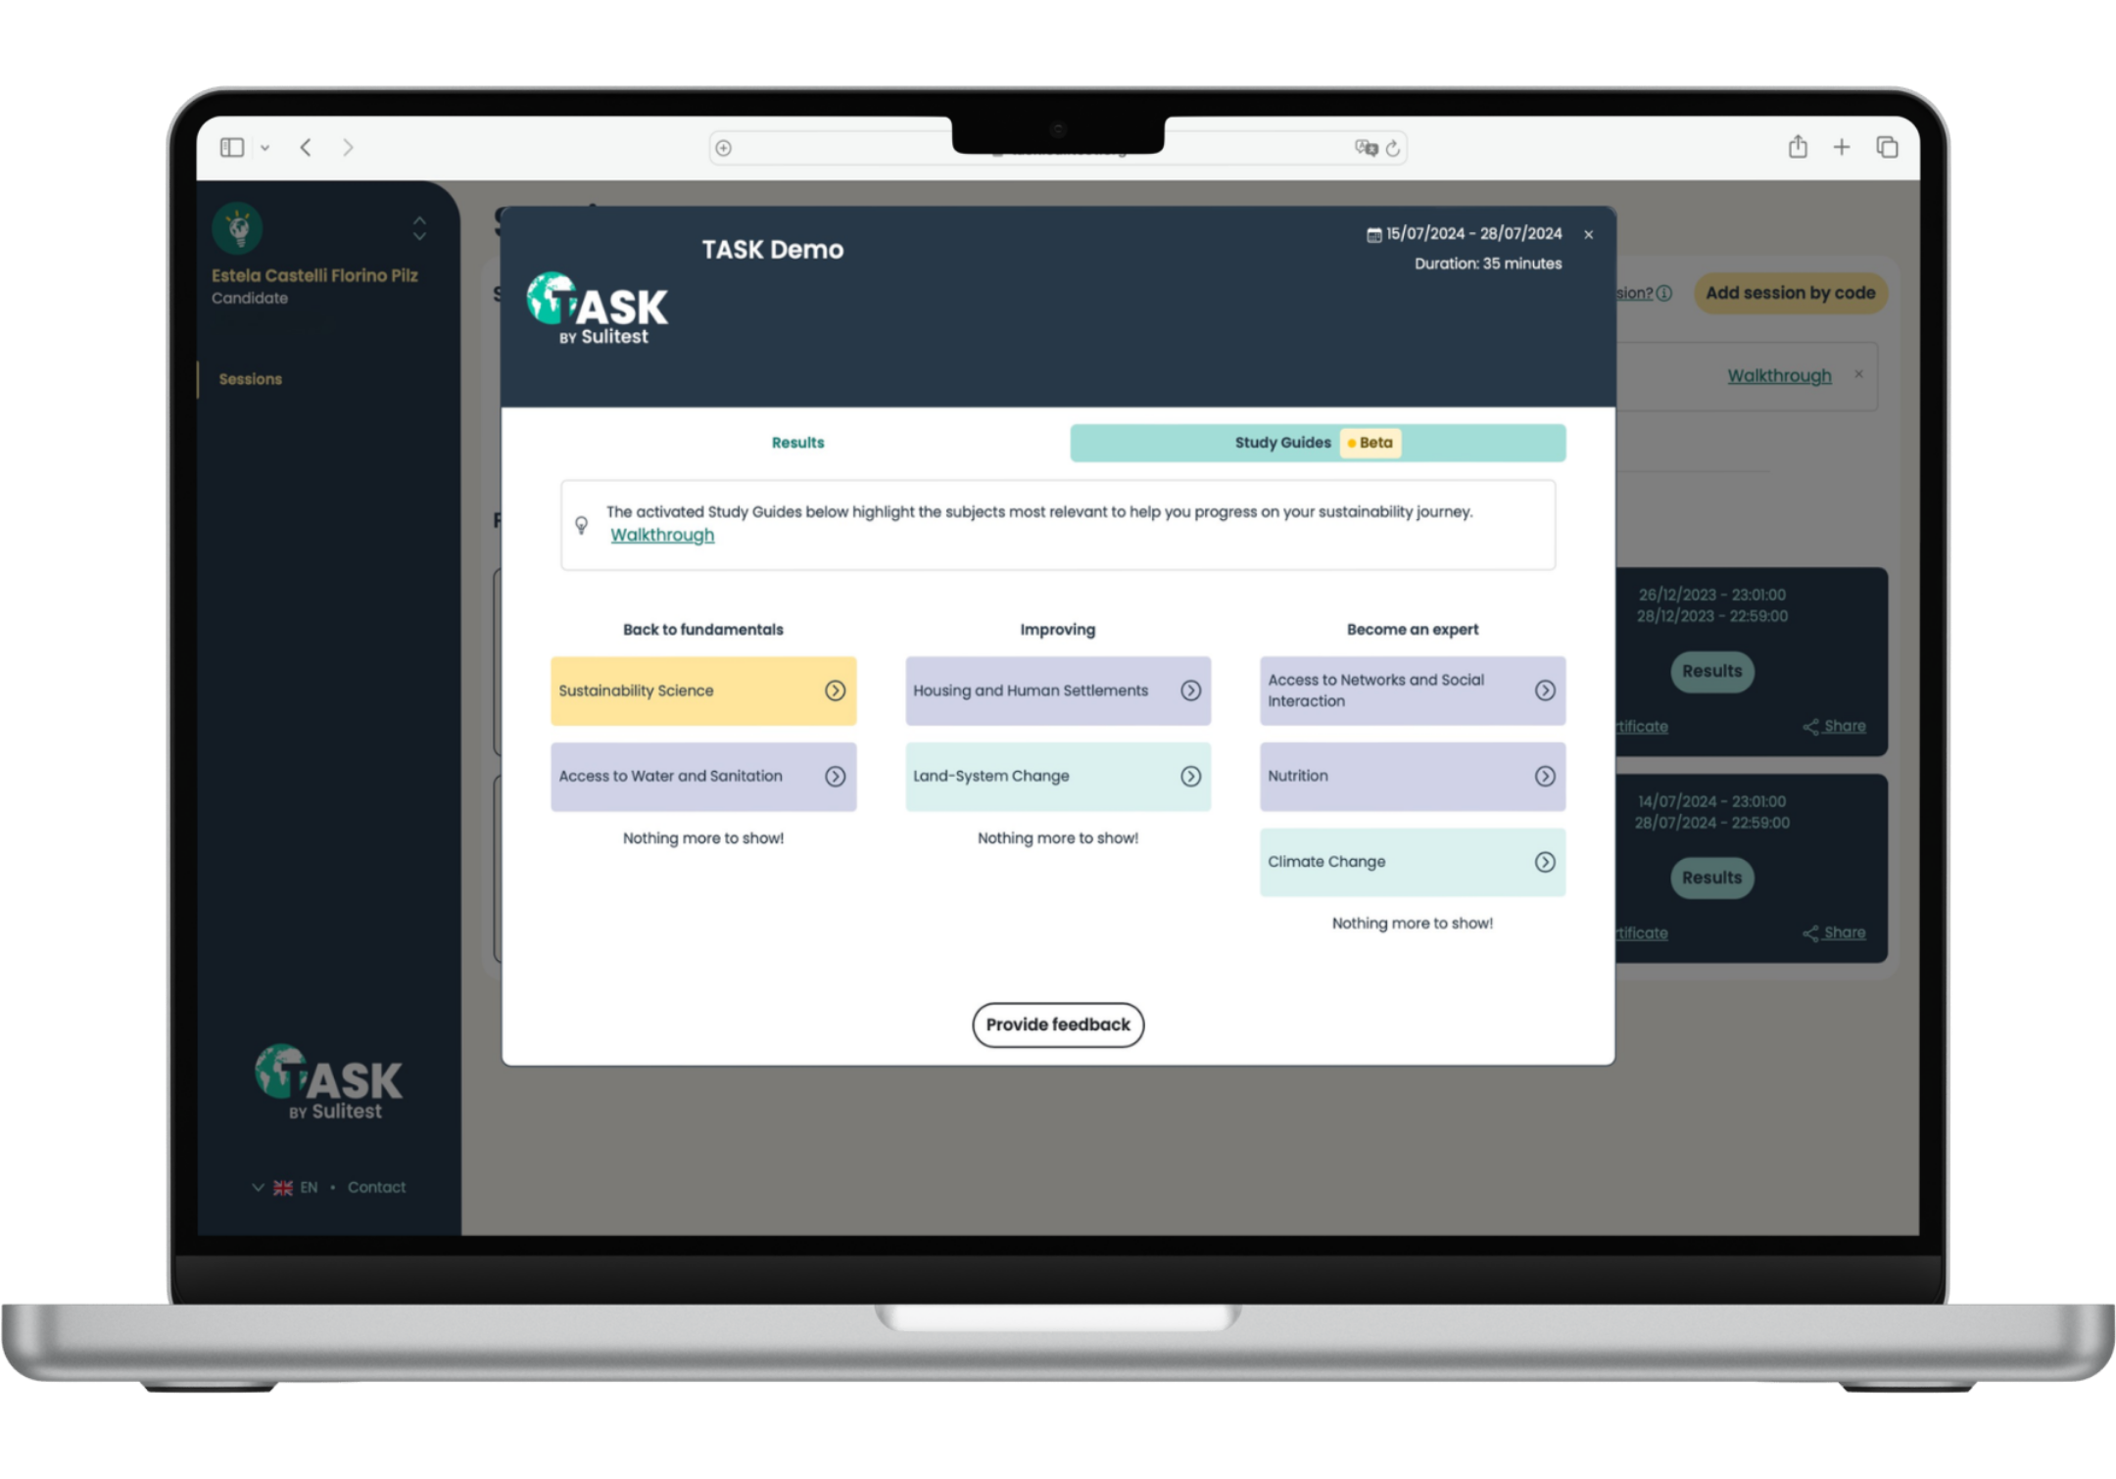
What are the Study Guides?
TASK™ Study Guides give you clear, structured support to understand sustainability topics more confidently.
Each guide is tailored to your results and helps you:
  Strengthen areas where you may need more practice
  Understand the key ideas behind each sustainability topic
  Keep learning with reliable, carefully selected resources

Slide 3
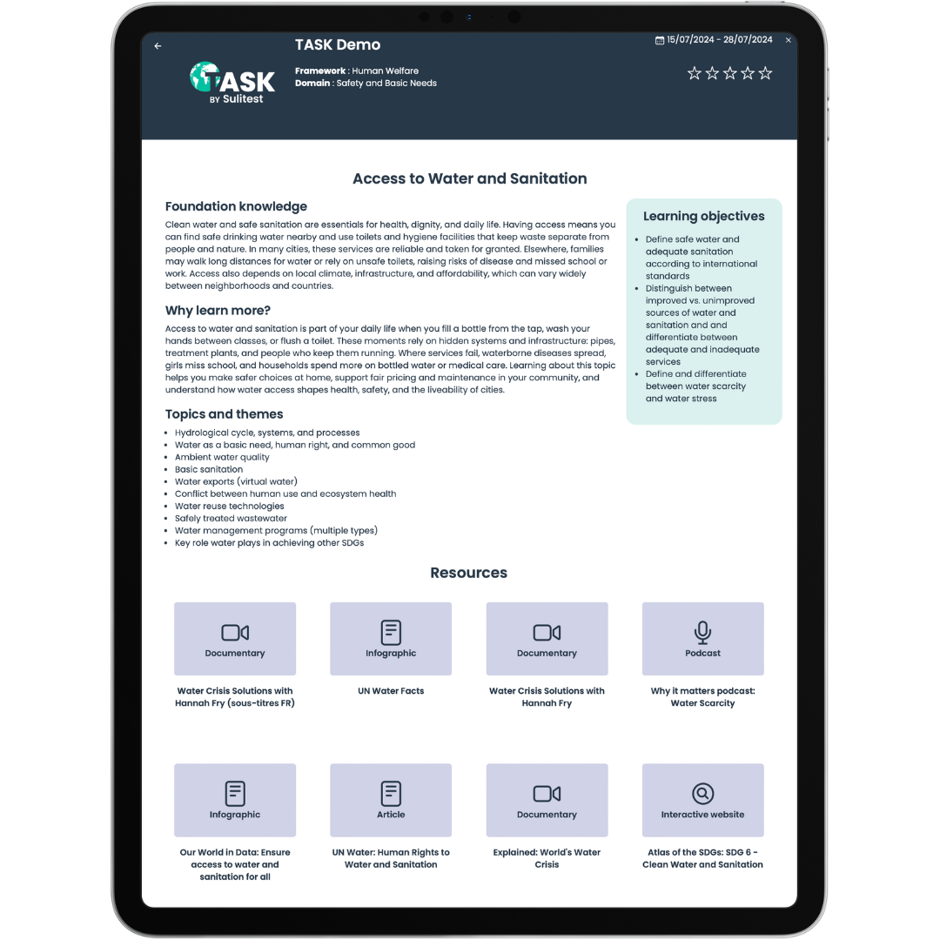
How the Study Guides work
Once you receive your TASK™ results:
You will get 5–10 personalised Study Guides
The guides you receive depend on your individual TASK™ score
Inside every Study Guide, you’ll find:
  Short explanations of the subject and why it matters
  Main topics to explore and learning objectives
  Curated articles, videos, and references

Slide 4

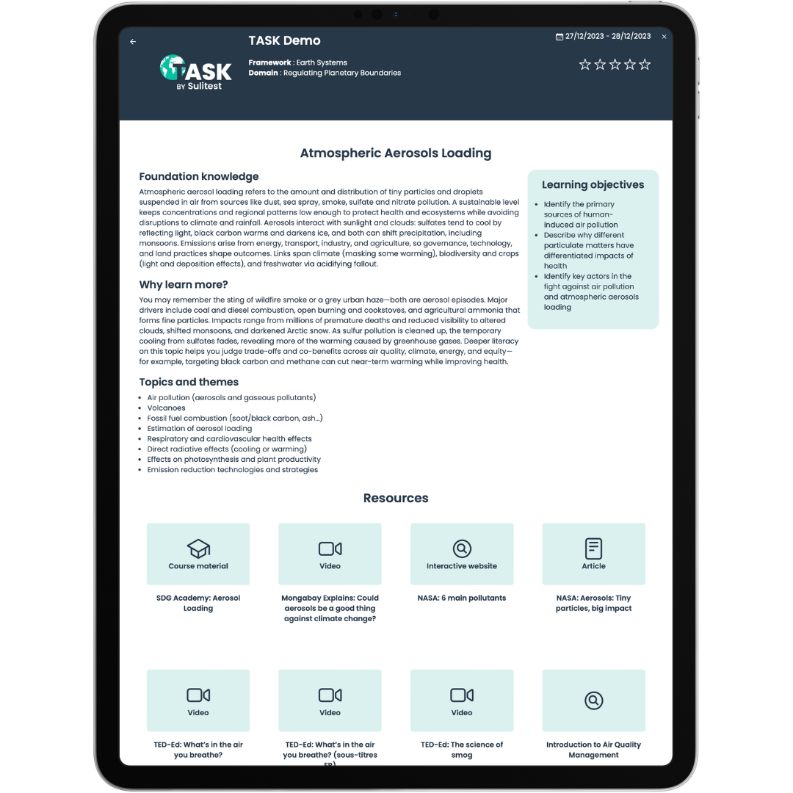

Why use the Study Guides?
They’re a simple and practical way to:
  Review topics you didn’t fully master
  Prepare for classes or deepen your knowledge independently
  Explore subjects that may be new or outside your main area of study
  Connect sustainability themes to your own academic or career interests

Slide 5
How to access your Study Guides
Once your TASK™ results are ready:
Log into your TASK™ account
Click on the button “Results”
Click on the tab “Study Guides”
Explore the Guides
Share your feedback through the star rating in each Guide and the feedback form

